Slide 1
Spotify Music Genre Cluster Analysis

Slide 2
Outline
Summary
The Data
The Clustering Process
Cool Graphs
Interpret Cluster Membership
Limitations
Next Steps

Slide 3
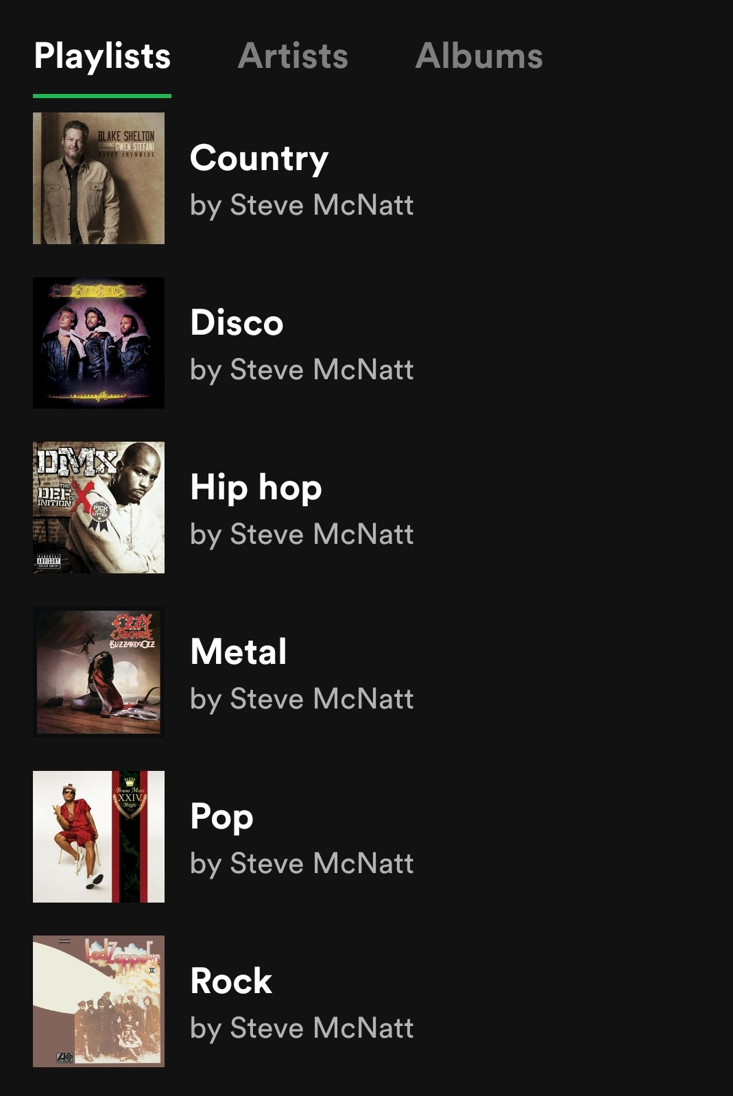
Summary
I would

Slide 4
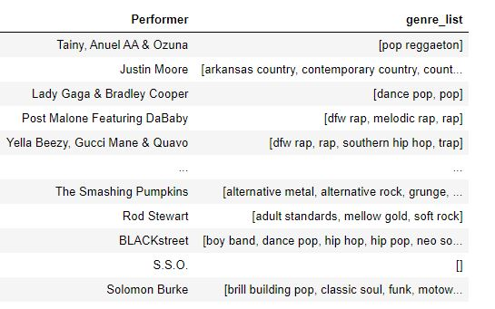
The Data
Weekly Hot 100 singles chart between 1958 and 2019, over 300,000 records
This file includes a list of music genres for each song as determined by Spotify:
Raw data available here

Slide 5
The Clustering Process
I used

Slide 6
Cool Graphs

Slide 7
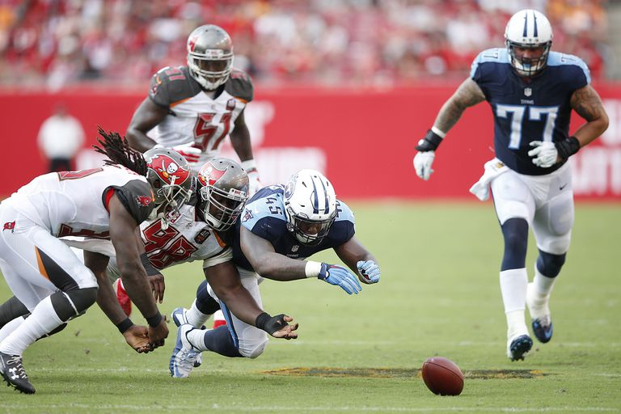
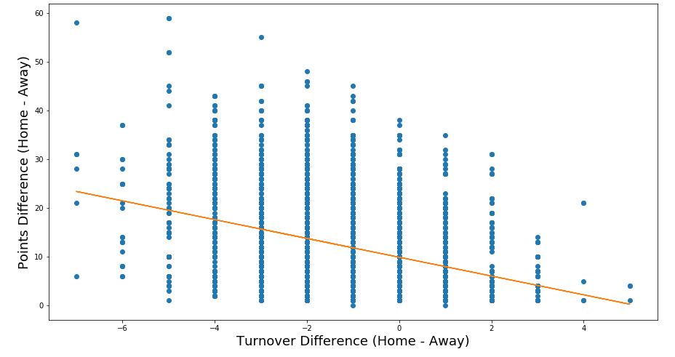
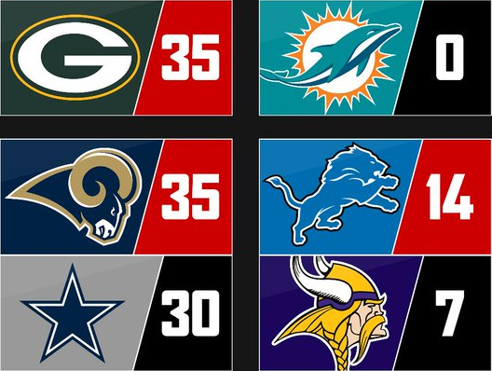
Points difference is larger on when away team has more turnovers
vs.

Slide 8
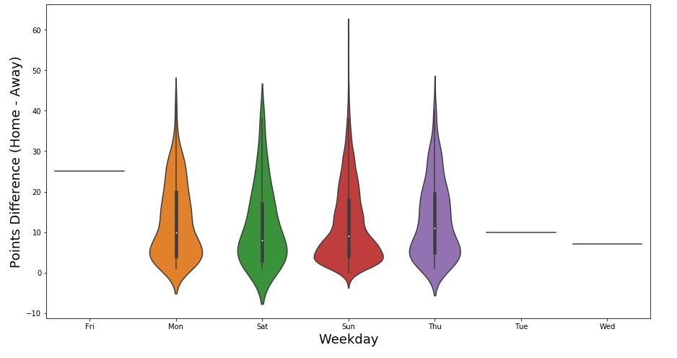



Points difference is larger on Sunday games

Slide 9
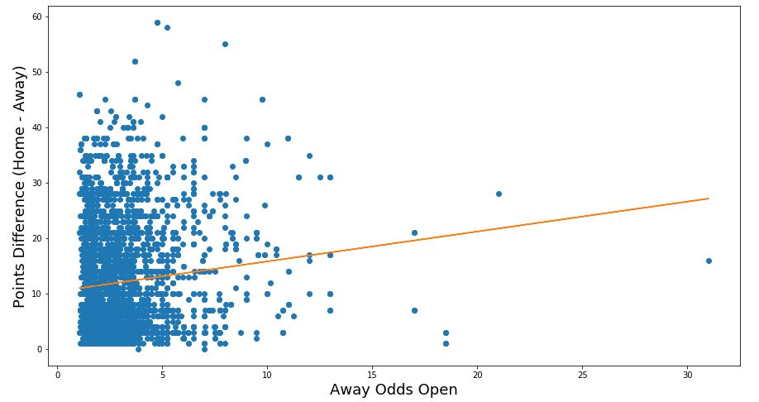
Points difference is larger when the odds are larger

Slide 10
Interpret Cluster Membership
When the

Slide 11
The
Limitations

Slide 12
Point
Next Steps

Slide 13
Questions?

